Slide 1





Slide 2




-
-
-
-
-

Slide 3


Slide 4



How do you communicate between containers?

Slide 5


Slide 6




docker network create --driver bridge isolated_network

Slide 7







Slide 8


docker network create
docker network ls
docker network rm [network]

Slide 10

docker run -d --net=isolated_network --name=mongodb
mongo

Slide 12

docker run –d –p 3000:3000 --net=isolated_network --name=nodeapp imageName

Slide 13


Slide 14












exec -it <containerId> sh
docker

Slide 15


Slide 16



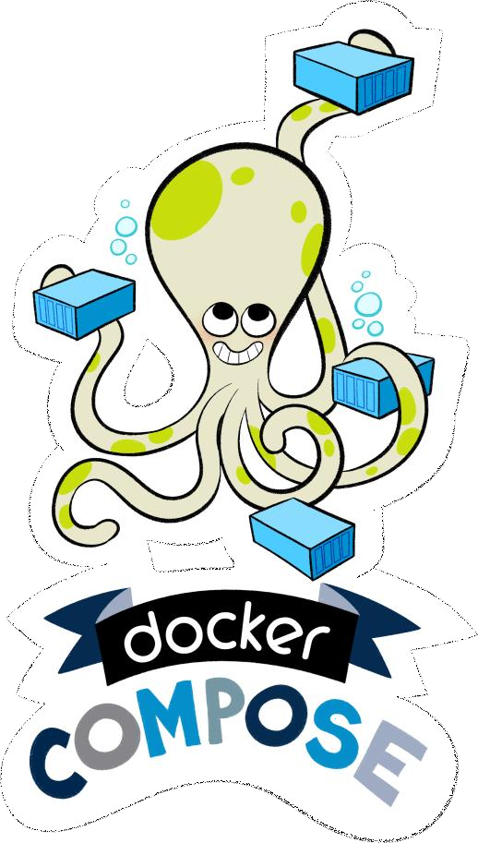


Slide 17








Slide 19
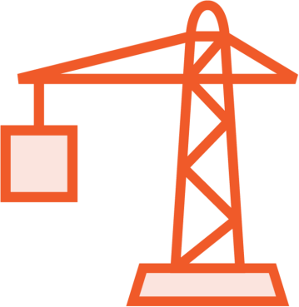

docker-compose build
docker-compose up
docker-compose down

Slide 21










-
-
-
-

Slide 22


